Slide 1

Geometry
Unit 9, Lesson 1 Finding the Area of Two-Dimensional Figures Volume 2, pg. 51

Slide 2


Benchmark
MA.912.GR.4.4
Solve mathematical and real-world problems involving the area of two-dimensional figures.
volume 2, pg. 51

Slide 3
Integrated Mathematical Thinking and Reasoning Standards
MA.K12.MTR.1.1 Actively participate in effortful learning both individually and collectively.
MA.K12.MTR.2.1 Demonstrate understanding by representing problems in multiple ways.
MA.K12.MTR.4.1 Engage in discussions that reflect on the mathematical thinking of self and others.
MA.K12.MTR.5.1 Use patterns and structure to help understand and connect mathematical concepts.
volume 2, pg. 51

Slide 4

Learning Target
I can solve mathematical and real-world problems involving the area of two-dimensional figures.
volume 2, pg. 51

Slide 5

Warm-Up
volume 2, pg. 51

Slide 6
9.1.1 Warm-Up: Michael Jordan
Basketball legend Michael Jordan is often quoted as saying, “I’ve failed over and over and over again in my life and that is why I succeed.”
What is a skill, activity, or subject that you have failed at?
Explain Jordan’s quote in your own words.
How can you turn a failure into a success story?
volume 2, pg. 51

Slide 7

Collaboration
volume 2, pg. 52

Slide 8

9.1.2 Collaboration: Finding Area
Complete the table.
How is the area of a triangle related to the area of a rectangle?
Figure | Area Formula
Rectangle
Triangle
volume 2, pg. 52

Slide 9
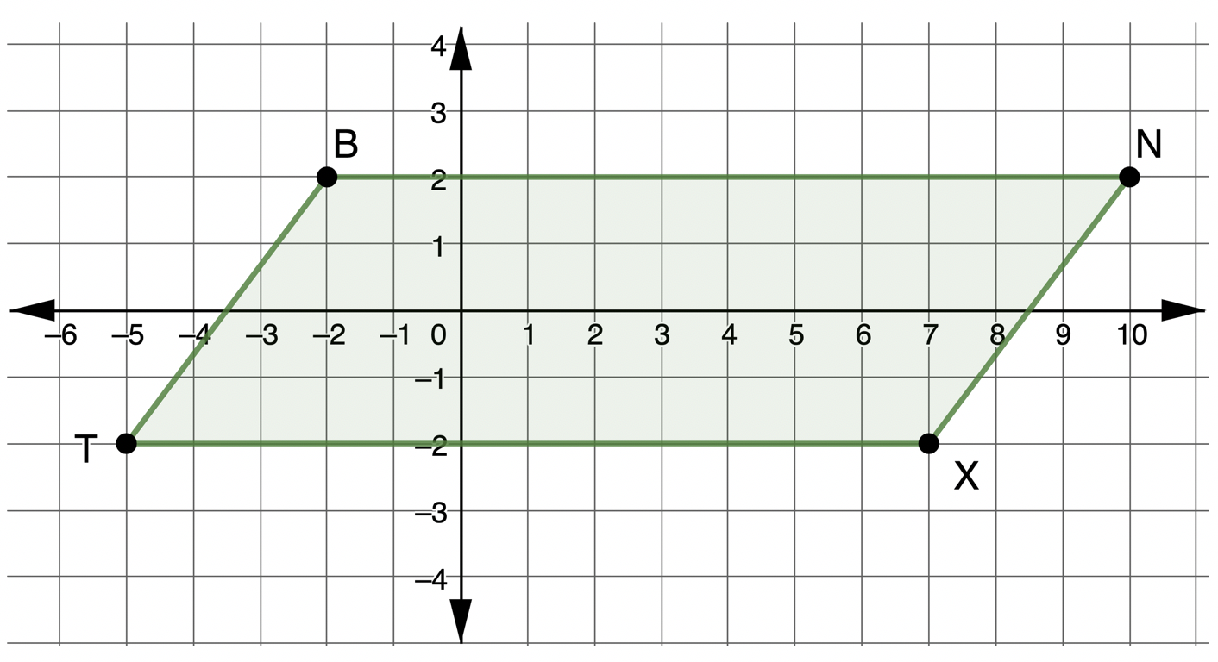
Parallelogram $BNXT$ is shown on the coordinate grid.
volume 2, pg. 52

Slide 10
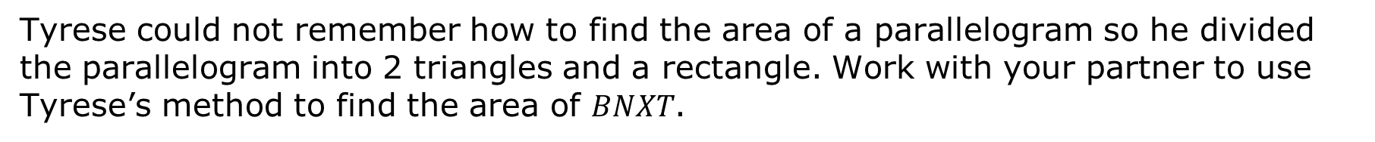
Tyrese could not remember how to find the area of a parallelogram so he divided the parallelogram into 2 triangles and a rectangle. Work with your partner to use Tyrese’s method to find the area of $BNXT$.
Shape | Area
Triangle 1
Triangle 2
Rectangle
Total Area of Parallelogram
volume 2, pg. 52

Slide 11
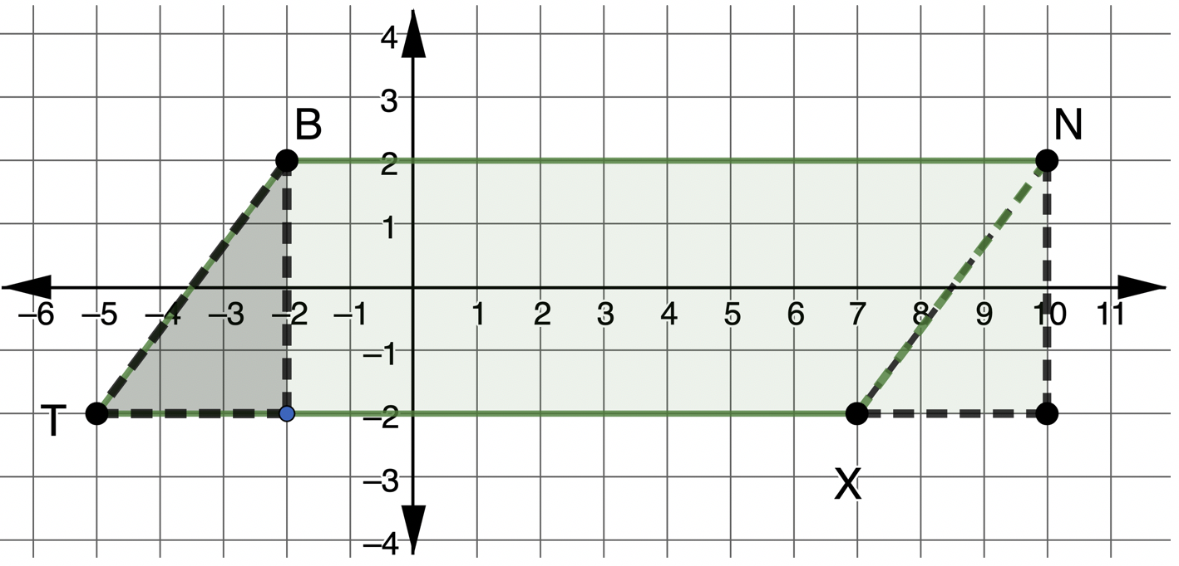

Sarianna rearranged the parallelogram to create a rectangle.
Use Sarianna’s rectangle to find the area of $BNXT.$
volume 2, pg. 53

Slide 12
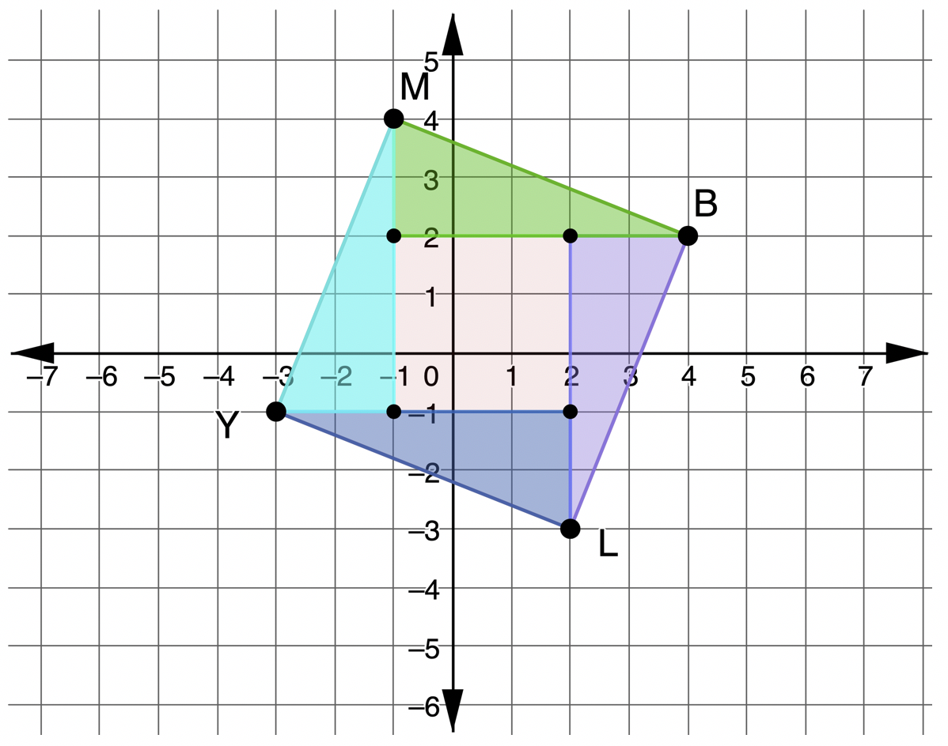
Quadrilateral $MBLY$ is decomposed as shown on the coordinate grid. Find the area of $MBLY$ using the decomposition shown.
volume 2, pg. 53

Slide 13
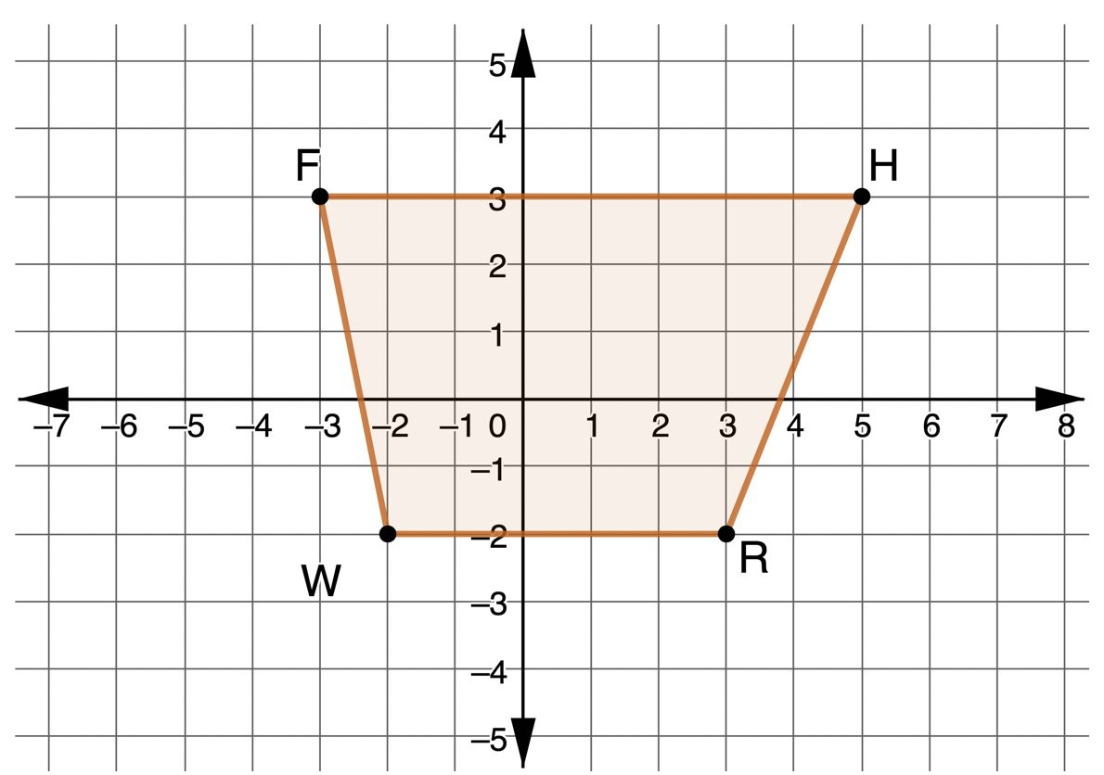
$FHRW$ is shown on the coordinate grid.
volume 2, pg. 54

Slide 14

Divide the quadrilateral into two triangles and a rectangle. Then, find the area of each.
What is the area of $FHRW$?
What type of quadrilateral is $FHRW$?
Shape | Area
Triangle 1
Triangle 2
Rectangle
volume 2, pg. 54

Slide 15
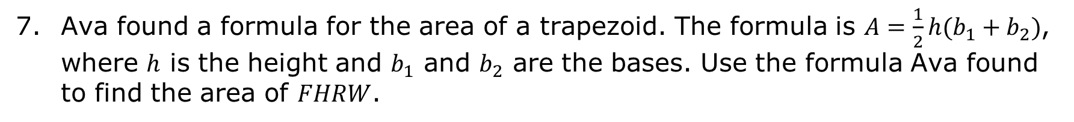
Ava found a formula for the area of a trapezoid. The formula is $A=\frac{1}{2}h(b_{1}+b_{2})$, where $h$ is the height and $b_{1}$ and $b_{2}$ are the bases. Use the formula Ava found to find the area of $FHRW$.
volume 2, pg. 54

Slide 16
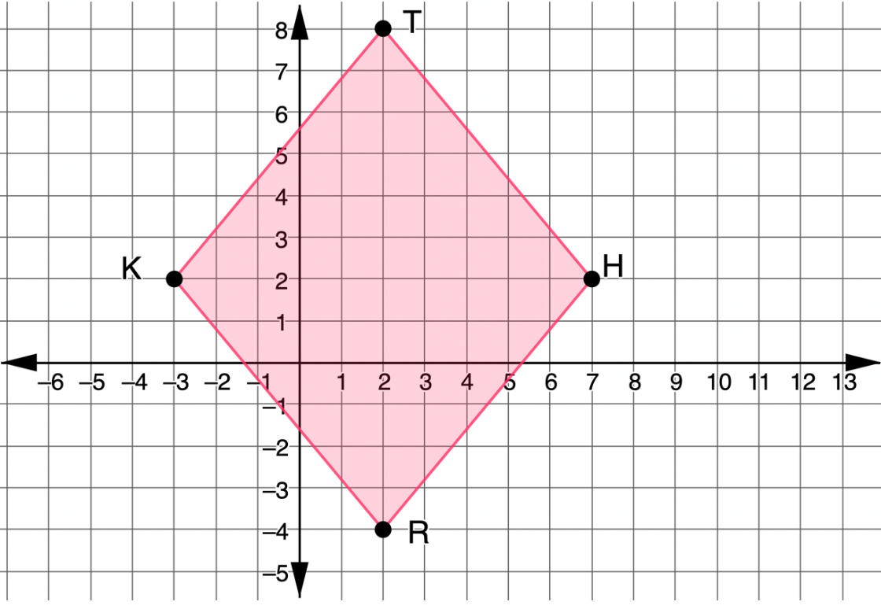

$THRK$ is shown on the coordinate grid.
What type of quadrilateral is $THRK$?
volume 2, pg. 54

Slide 17
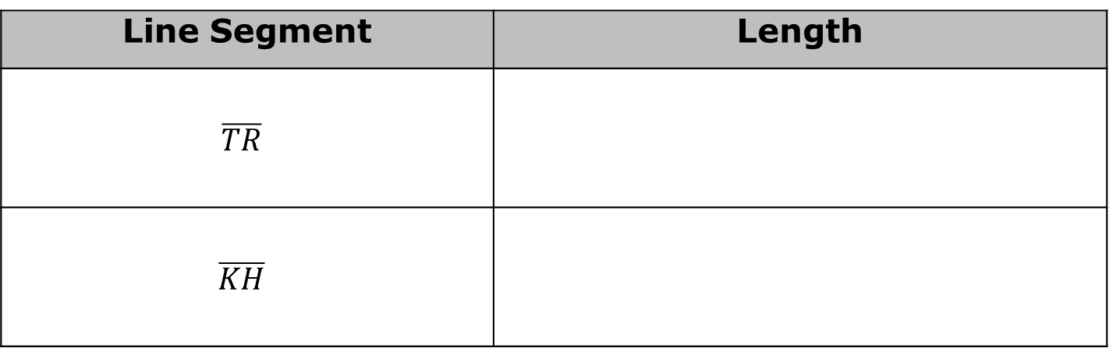
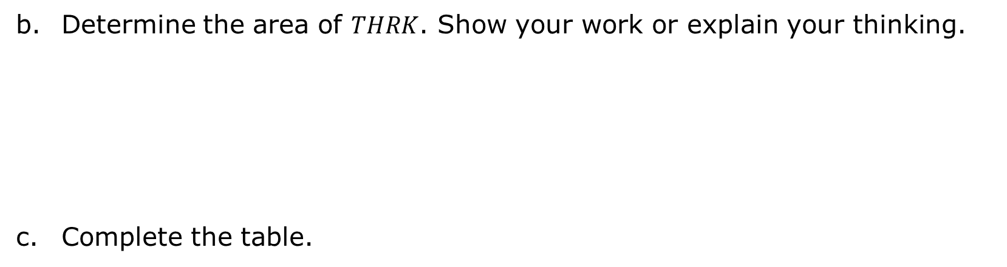
Determine the area of $THRK$. Show your work or explain your thinking.
Complete the table.
Line Segment | Length
$$\overline{TR}$$
$$\overline{KH}$$
volume 2, pg. 55

Slide 18
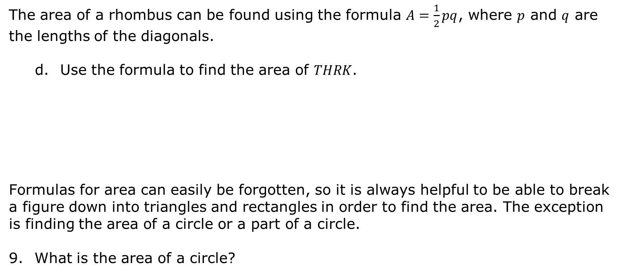
The area of a rhombus can be found using the formula $A=\frac{1}{2}pq$, where $p$ and $q$ are the lengths of the diagonals.
Use the formula to find the area of $THRK$.
Formulas for area can easily be forgotten, so it is always helpful to be able to break a figure down into triangles and rectangles in order to find the area. The exception is finding the area of a circle or a part of a circle.
What is the area of a circle?
volume 2, pg. 55

Slide 19
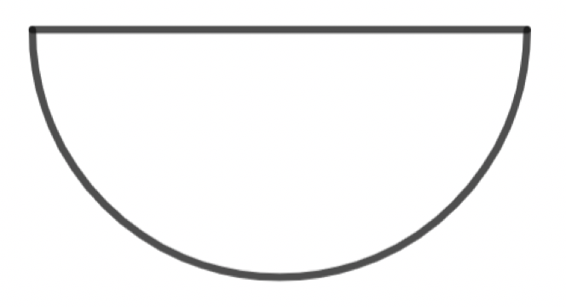
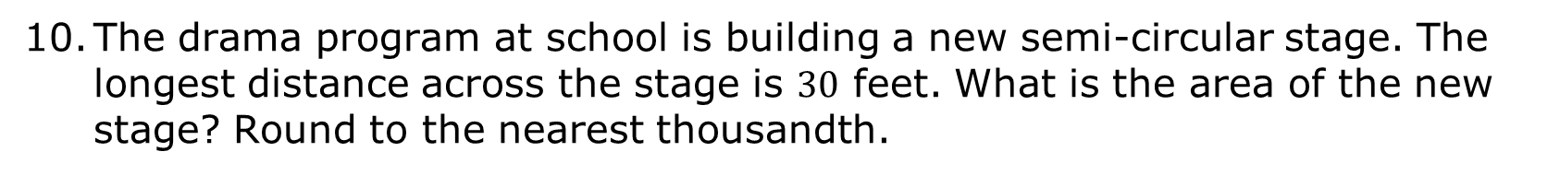
The drama program at school is building a new semi-circular stage. The longest distance across the stage is $30$ feet. What is the area of the new stage? Round to the nearest thousandth.
volume 2, pg. 56

Slide 20

Guided Practice
volume 2, pg. 56

Slide 21

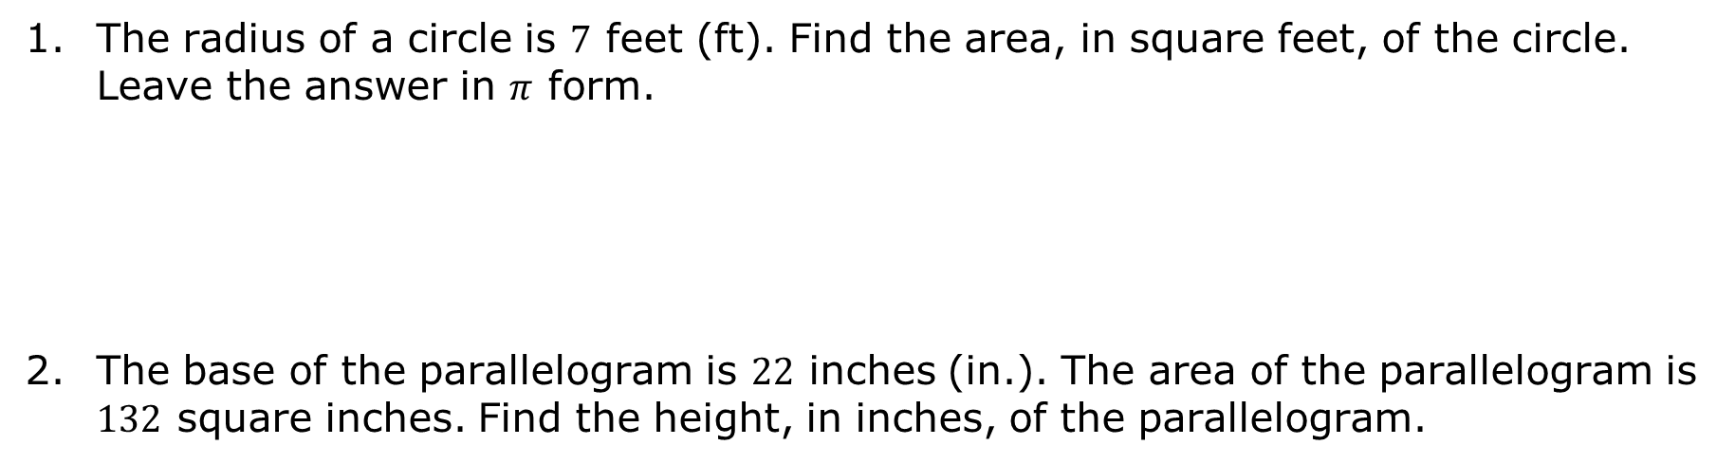
9.1.3 Guided Practice: Using the Formulas
The radius of a circle is $7$ feet (ft). Find the area, in square feet, of the circle. Leave the answer in $π$ form.
The base of the parallelogram is $22$ inches (in.). The area of the parallelogram is $132$ square inches. Find the height, in inches, of the parallelogram.
volume 2, pg. 56

Slide 22
The diagonals of a rhombus are 40 centimeters (cm) and 18 centimeters. Find the area, in square centimeters, of the rhombus.
volume 2, pg. 57

Slide 23
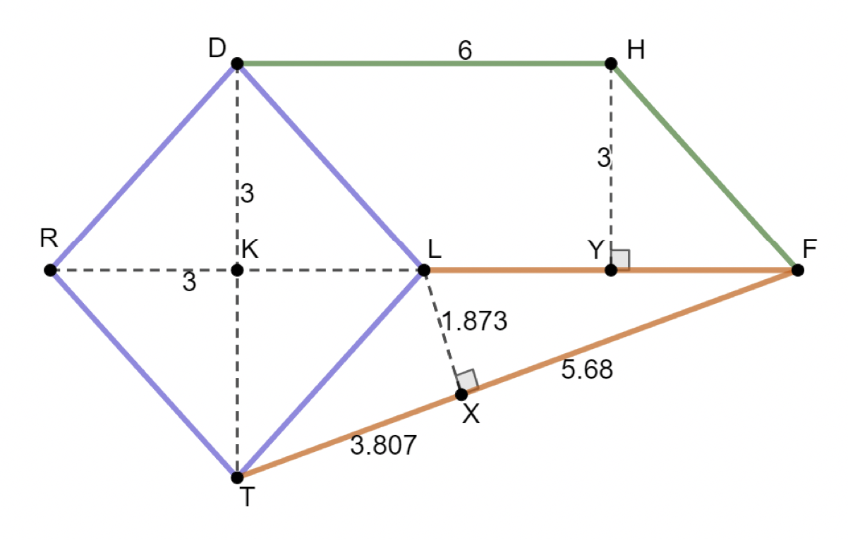
A composite shape of a rhombus, a parallelogram, and a triangle is shown.
volume 2, pg. 57

Slide 24
Complete the table. Round to the nearest thousandth.
Shape | Area
Rhombus
Parallelogram
Triangle
Composite Area
volume 2, pg. 57

Slide 25

Your Turn
volume 2, pg. 58

Slide 26
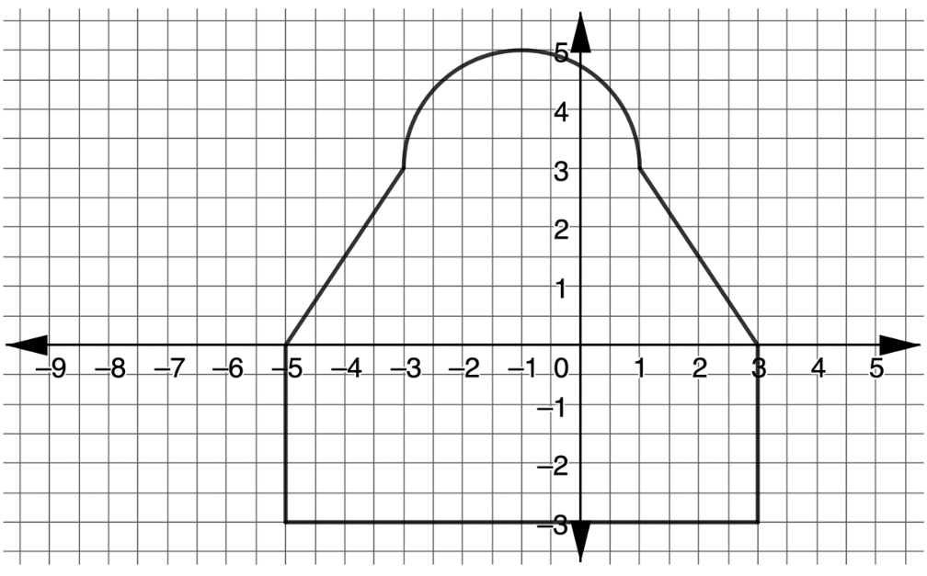

9.1.4 Your Turn!
The design of a room is shown, where $1$ unit = $5$ feet.
Determine the area, in square feet, of the room. Round to the nearest thousandth.
volume 2, pg. 58

Slide 27

Wrap-Up
volume 2, pg. 58

Slide 28
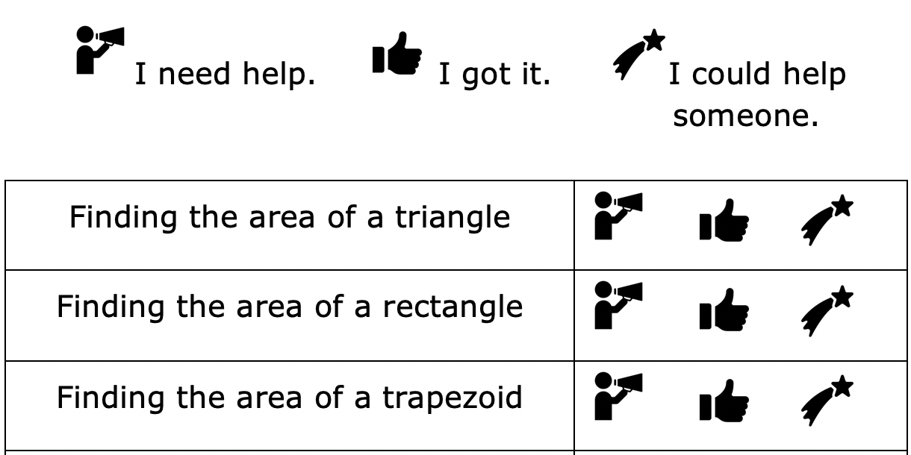
9.1.5 Wrap-Up: Reflection
Circle the icon that best describes your understanding of each.
volume 2, pg. 58

Slide 29
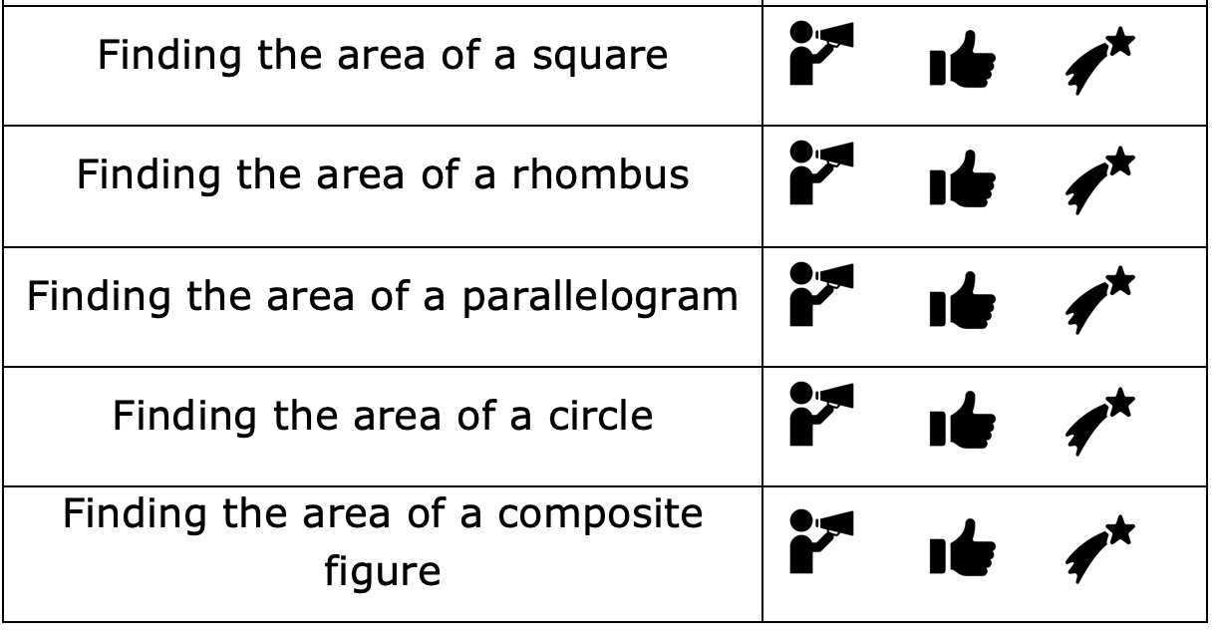
volume 2, pg. 58

